Slide 1

Computer Vision & Pretrained Models p.2
14 Aug
2026
AI Summer Training Course - Level 2
Presented to you by: Mahmoud Sayed
AI and Machine Learning Track

Slide 2
Course Content
01. Quick review of neural network concepts
02. Common Computer Vision Tasks
03. CNN architectures, Convolution layers and filters
04. Image preprocessing and augmentation
05. Training, validation and evaluation for image classification
06. Why pretrained models are used in real computer vision projects
07. Transfer learning workflow and freezing and unfreezing layers
08. Common pretrained model families
09. Saving and reusing trained models

Slide 3
Softmax
Neural Networks output Logits [float values] in the final layer, not probabilities
The most probable class will have a higher value than the rest
We won’t to convert these logits into probabilities
This is where softmax takes place, It turns the output logits into probabilities

Slide 4
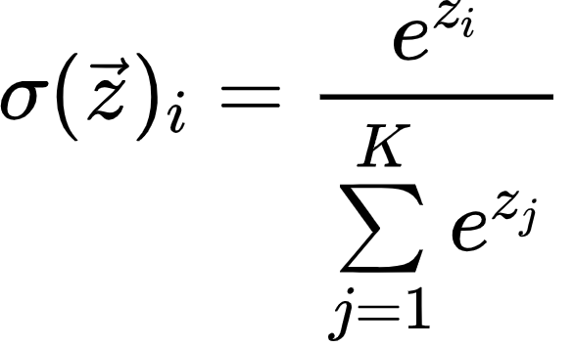
Softmax
Example:
Network output: [5, 7, -12]
p1 = e^5/(e^5 + e^7+e^-12) = 0.12
p2 = e^7/(e^5 + e^7+e^-12) = 0.88
p3= e^-12/(e^5 + e^7+e^-12) = almost 0

Slide 5
Adaptive Average Pooling
Creates an average filter in the same size as the input image, and averages its values resulting in a single value
Applying that over a feature map of size CxHxW results in a Cx1x1 vector
This vector represent the finest features of the input image

Slide 6
What are pretrained models
Pretrained models are deep learning models that have been already trained on massive amounts of data.
In context of computer vision, after training a CNN on a large dataset such as ImageNet1k, the network’s kernels became general purpose feature extractors because they have been exposed to huge amounts of features and visual patterns during training.
You can utilize the knowledge or the feature extraction capabilities of pretrained models and adapt them on new datasets, this process is called Transfer Learning

Slide 7
Transfer Learning
Using knowledge learned from one task/domain to help solve another.
There are 2 types of transfer learning:
Feature Extraction
Fine-tuning
Whether it’s fine-tuning or feature extraction, you do something called Freezing

Slide 8
Freezing
Freezing is a process where you freeze some of a neural networks layer
Freezing a layer means that this layer won’t get gradients calculated, nor will it have its parameters updated
We assume that the given layer is already a good feature extractor since it was already trained on a broader task, so we don’t need to update it further.

Slide 9
Freezing
The main difference between Feature Extraction and Fine-tuning lies in how many layers are getting frozen
In Feature extraction, we freeze the entire network and only train the classification/regression head
In Fine-tuning we freeze some or none of the networks layer and the classification head is also trained.

Slide 10
Feature Extraction
As we said earlier, in feature extraction, you freeze the entire network, replace the classification head with a new classification head depending on the classes you want to predict, and then train the network.
You do that when you believe the network’s layers already are good enough feature extractors, they will extract meaningful features from your current dataset.

Slide 11
Feature Extraction
Feature Extraction is often only used when your dataset is small. Why?
Neural networks are known to have LOTS of parameters by design, trying to tune a large number of parameters on a small dataset leads to overfitting.
You also use Feature Extraction when you are confident that the new dataset has a similar domain to the domain the model was originally trained on.

Slide 12
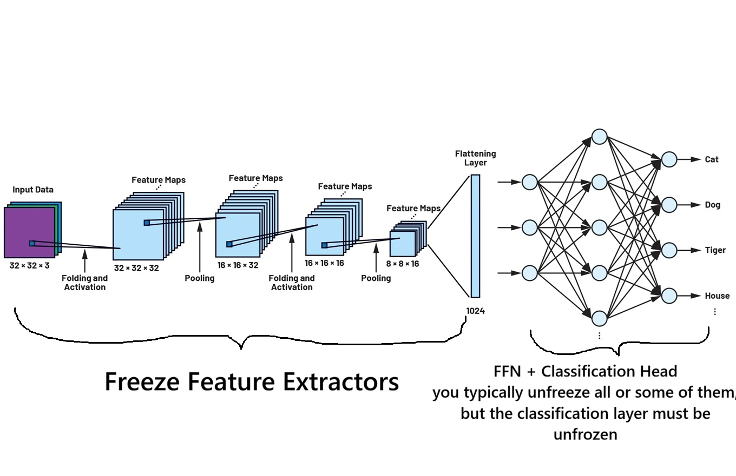
Feature Extraction

Slide 13
Fine-tuning
In fine-tuning, we only some layers of a neural network, as well as a new classification head
We can also keep the whole network unfrozen, and fine-tune it on a new dataset
Be careful though, you probably don’t want the model to heavily change the original weights, you want it to keep some of its original knowledge.
This problem is called Catastrophic forgetting.
To avoid that, you use a low learning rate during fine-tuning.

Slide 14
Fine-tuning
Fine-tuning is often used when you have a larger dataset
You can use it even with a shift in domain, though, the more the domain differs, the more layers you need to unfreeze, but even this is still constrained by the size of the dataset at hand.
It allows the model use a mixture of pretrained feature extractors + some dedicated feature extractors for the task/domain at hand
In case of full fine-tuning, either use a low learning across the entire network, or give a low learning rate for early layers and progressively increase the learning rate as you progress through the layers

Slide 15
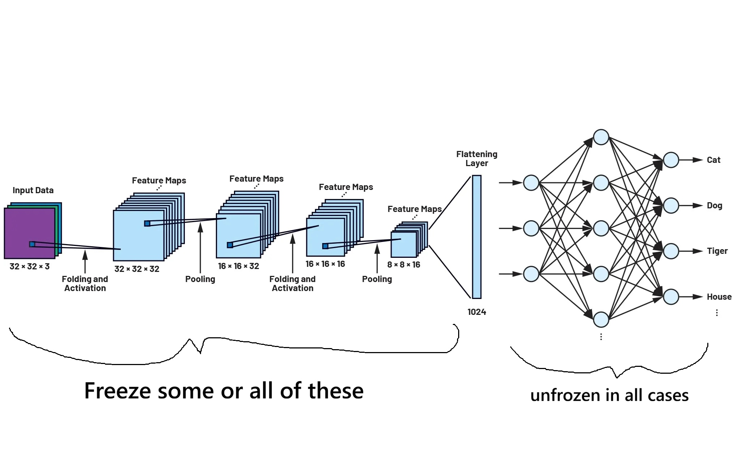
Fine-tuning

Slide 16
Common Pretrained Models Family
These Models are some of the most common models used for transfer learning tasks:
AlexNet
VGG [16 and 19]
ResNets [18, 50, ….]
MobileNets [v1, v2, v3]
EfficientNets
ConvNext
Vision Transformer (VIT)

Slide 17
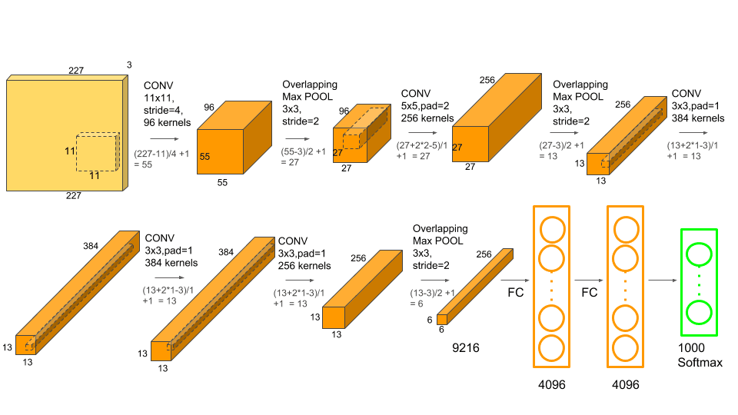
AlexNet
The most basic and simple for of a CNN

Slide 18
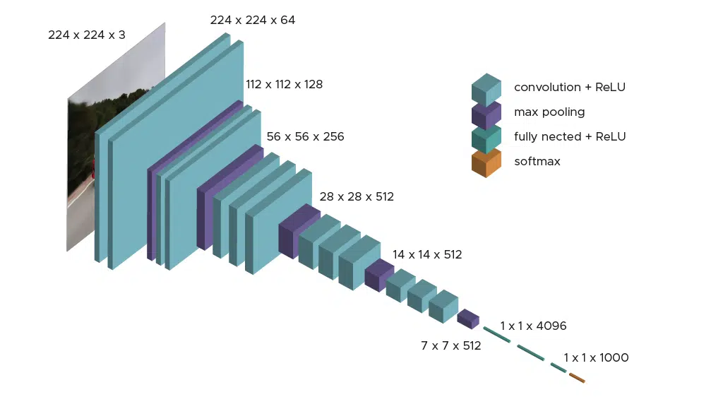
VGG
A cleaner version of AlexNet
More depth [16 and 19]
More channels per layer
Utilized 3x3 conv instead of 11x11

Slide 19
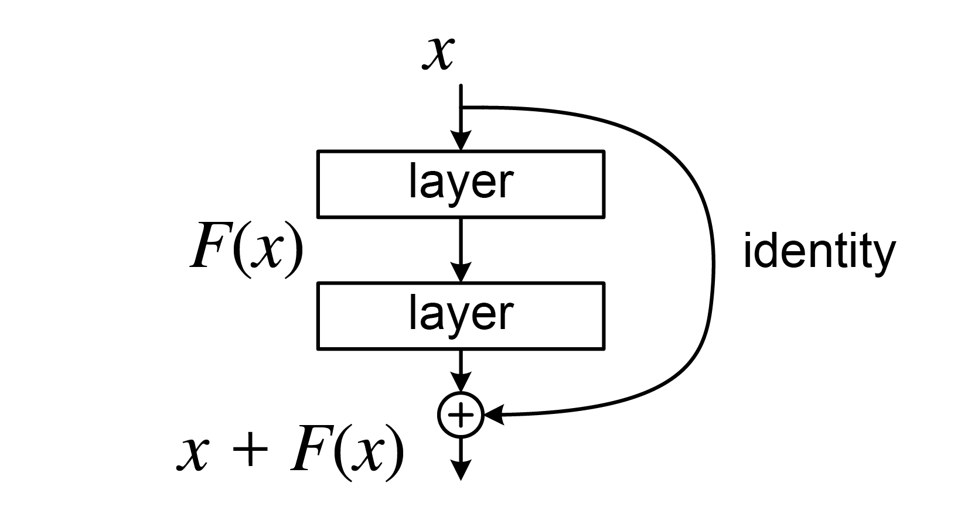
ResNet
The deeper the network went, the more their accuracy increased, but at some threshold, accuracy started dropping instead of increasing.
Introduced Residual Blocks which allow gradients to flow throughout the network without vanishing.
Residual Blocks are implemented as bottleneck layers: wide -> narrow -> wide
decrease number of channels temporarily -> operate on them -> increase them back.
Allows for far deeper network without losing accuracy [up to 1000 :o]
Allows the model to keep track of the how the input image originally looked like without forgetting it the deeper the network goes
The model learns what needs to be changed on the input
rather than changing the input itself
The idea of residual block is used in almost all networks that came later
until today.

Slide 20
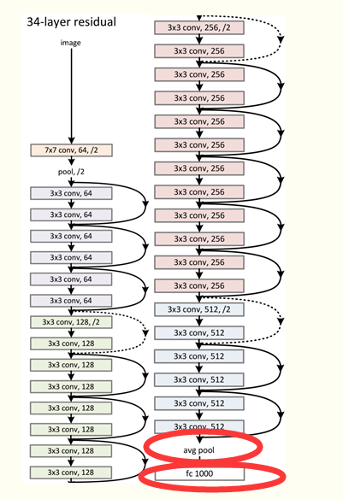
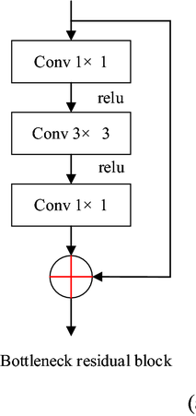
ResNet
Bottleneck Residual block, another view
Before resnet, such depths were not possible

Slide 21
MobileNet
Mobilenet is built for [as its name suggests] mobile use cases, it’s especially designed for cases that require low memory and low inference latency.
There are 3 versions of mobilenet, we will focus on v1 and v2.
Has a low number of parameters compared to other models, but ensures parameter efficiency [all parameters contribute to the output]

Slide 22
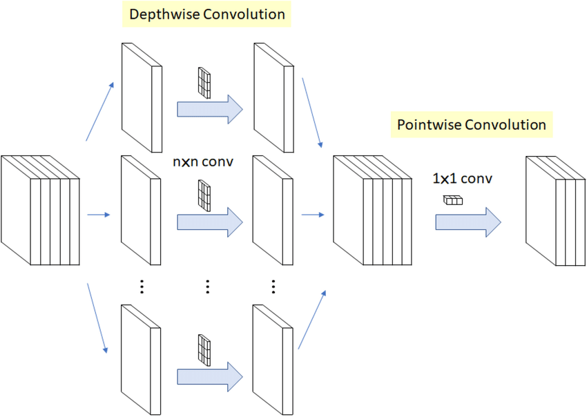
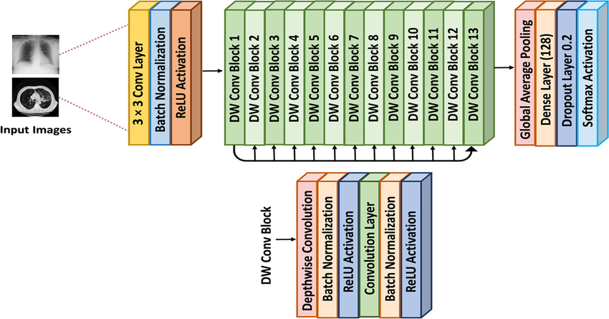
MobileNet
Uses depthwise-separable convolution, a method of performing convolution with lower number of FLOPs as well as memory
Introduced 2 parameters Width Multiplier (α) and Resolution Multiplier (ρ)
Width multiplier (α) controls how deep each layer is [how many channels]
Resolution Multiplier (ρ) controls the input image resolution
so , you have a baseline MobileNetv1 with a specific set of hyper-parameters (α) and (ρ) scale them down

Slide 23
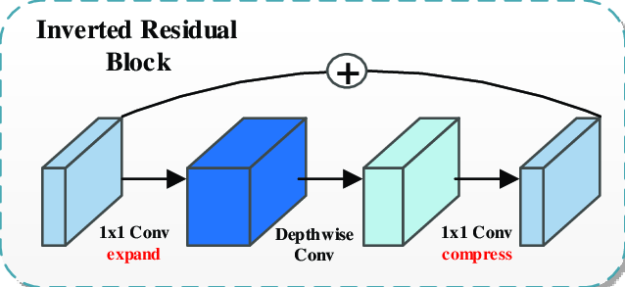
MobileNet
MobileNet v2 introduced inverted residual block, which is basically a residual block but inverted
Narrow -> wide -> narrow
Increases number of channels temporarily, operates on them, decreases them again

Slide 24
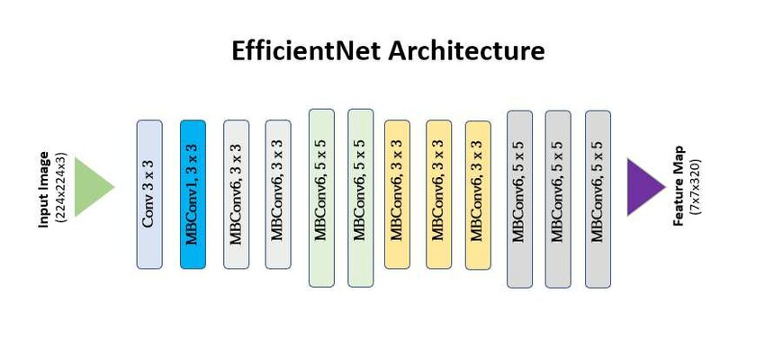
EfficientNets
Designed to have high accuracy with a relatively low number of parameters, so it aims to achieve parameter efficiency
Uses 3 parameters to scale its input and internals:
α^ϕ to scale its depth [number of layers]
β^ϕ to scale to scale its width [number of channels]
γ^ϕ to scale the input image size
As you can see, they’re all ruled by the ϕ power so, we basically scale them all together at the same time
Uses inverted residual block with depthwise-separable convolution just like mobilenets but also uses a method called squeeze-and-excitation within

Slide 25
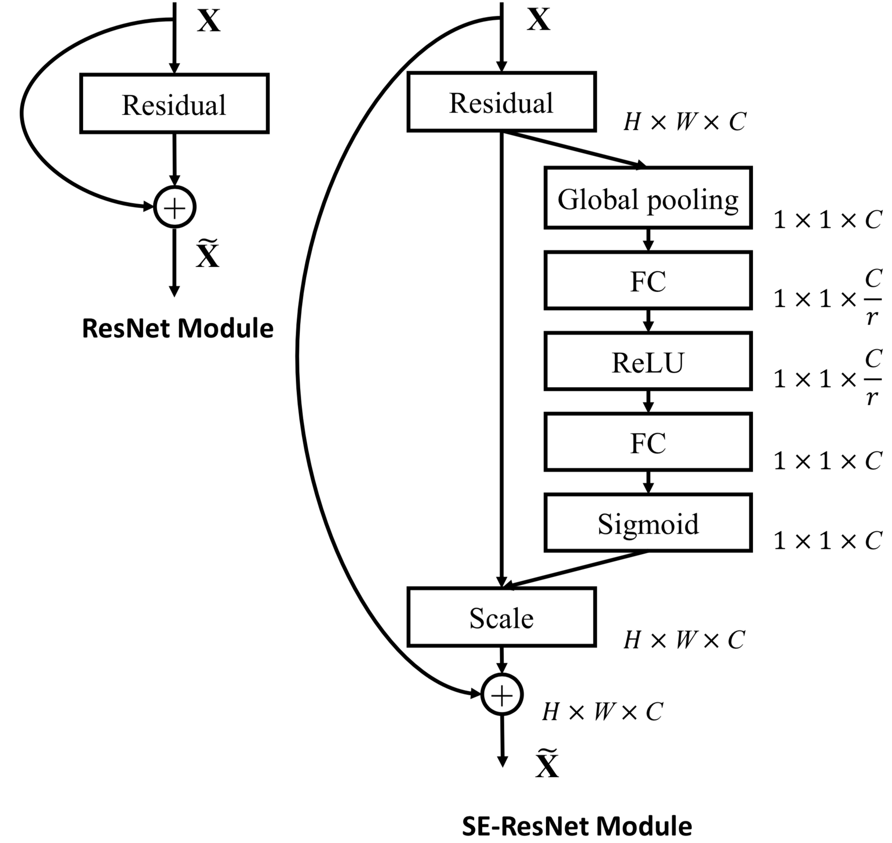
EfficientNets
Squeeze-and-excitation is a method used to allow the network to know which channels are the most useful, scale them by their importance factor to make them even more impactful.
It’s achieved by using Global Average Pooling and an FFN followed by a sigmoid
Might sound more like squeeze-and-inhibition not excitation

Slide 26
EfficientNets
Squeeze-and-excitation is a method used to allow the network to know which channels are the most useful, and excite/scale them by their importance factor to make them even more impactful.
It’s achieved by using Global Average Pooling and an FFN followed by a sigmoid
Might sound more like squeeze-and-inhibition not excitation

Slide 27
Vision Transformer
One of the strongest networks ever created until now
One of the best backbone networks
Utilizes the transformers architecture that were originally created for sequence and language modeling
Transformers are originally made for sequence modeling
Images are not sequences
So they had to come up with a way to represent an image as a sequence so that they can use it with transformers

Slide 28
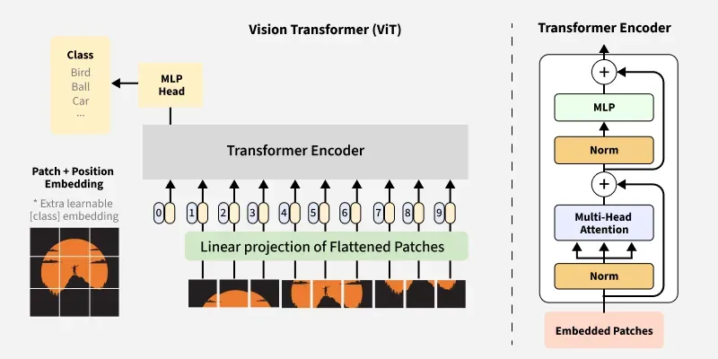
Vision Transformer

Slide 29
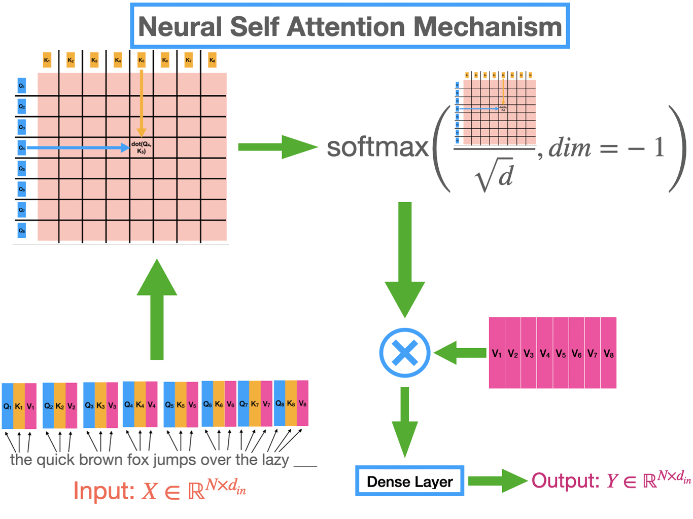
Attention Mechanism (very briefly)
Attention Mechanism allows tokens [parts of a sequence, or image patches in our case] to directly interact with each other and pass information to each other
Each patch has Query, Key and Value vectors
All Q and K vectors are multiplied using dot product, the result value tells you how much a patch is important to another patch [or carries information that’s important to another patch]
This importance score is multiplied by the value vector
and then value vectors from patches are passed to other
patches to influence each other

Slide 30
Other countless architectures

Slide 31
Using Backbones for different tasks
You can use Models that are trained on classification for example, as a backbone for an entirely different task such as segmentation, detection, etc, etc. and they already perform great.
Though, better approaches have been discovered to avoid potential bias towards original task
Some models are trained to understand visual information in general without being trained on a specific task such as classification, segmentation, ….
One great example on such models is DINO backbone

Slide 32
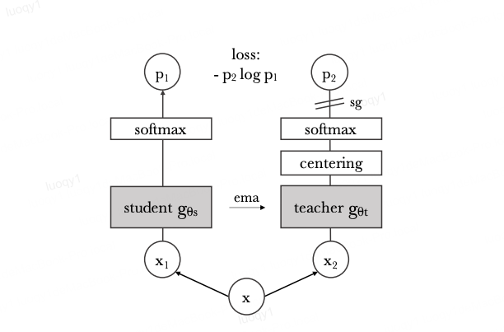
DINO backbone
Dino backbone is not trained on a specific downstream task like classification or segmentation
It’s rather trained using something called “self supervised learning”
There are 3 DINO versions until now, each fixes the problems of the previous version and improves the overall performance and feature extraction capabilities
They utilize the ViT architecture
DINO is trained using a mechanism called self-distillation

Slide 33
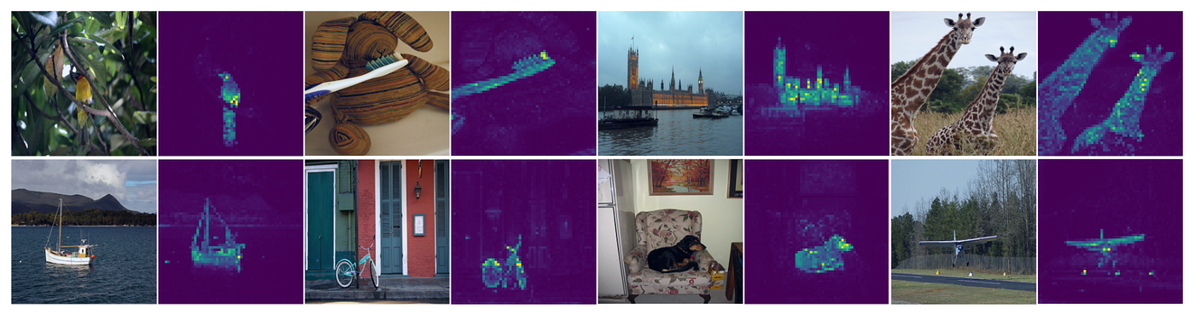
DINO backbone
DINO feature extraction capabilities

Slide 34
Thanks for your attention

